Slide 1
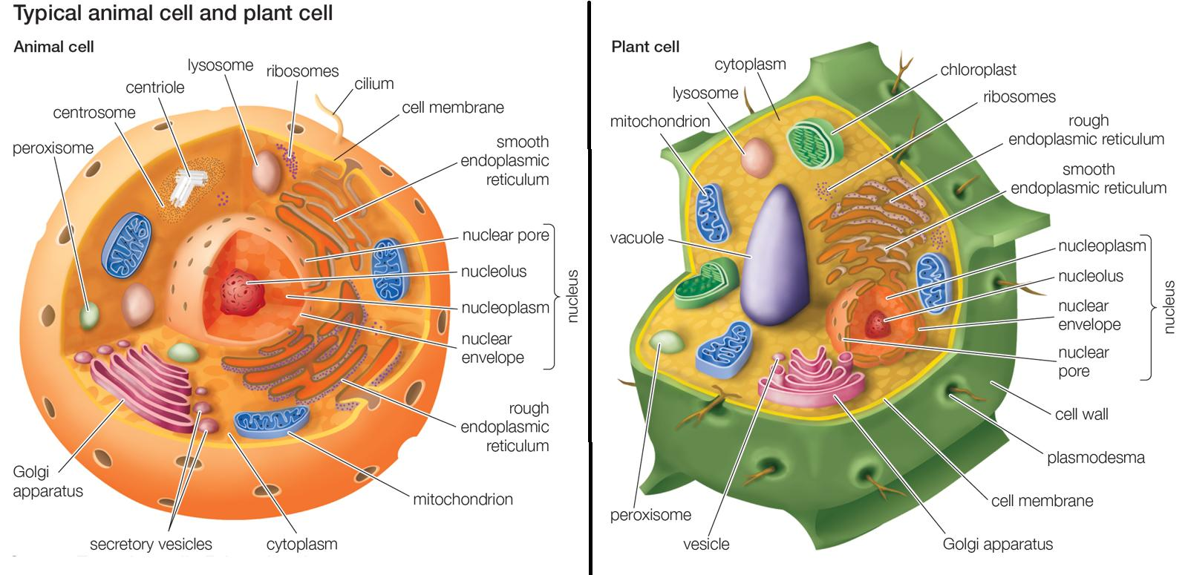
Differences between Animal Cells and Plant Cells

Slide 2
1. Size: Animal cells are generally smaller than plant cells. Animal cells range from 10 to 30 micrometers in length, while plant cells range from 10 and 100 micrometers in length.
2-Shape: Animal cells come in various sizes and tend to have round or irregular shapes. Plant cells are more
similar in size and are typically rectangular or cube shaped.
3. Energy Storage: Animals cells store energy in the form of the complex carbohydrate glycogen. Plant cells store energy as starch.

Slide 3
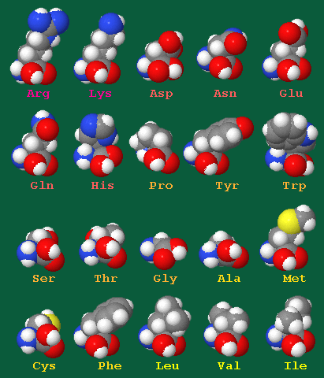
Proteins: 20 amino acids needed to produce proteins, only 10 can be produced naturally in animal cells. The other so-called essential amino acids must be acquired through diet. Plants are capable of synthesizing all 20 amino acids.

